Slide 1
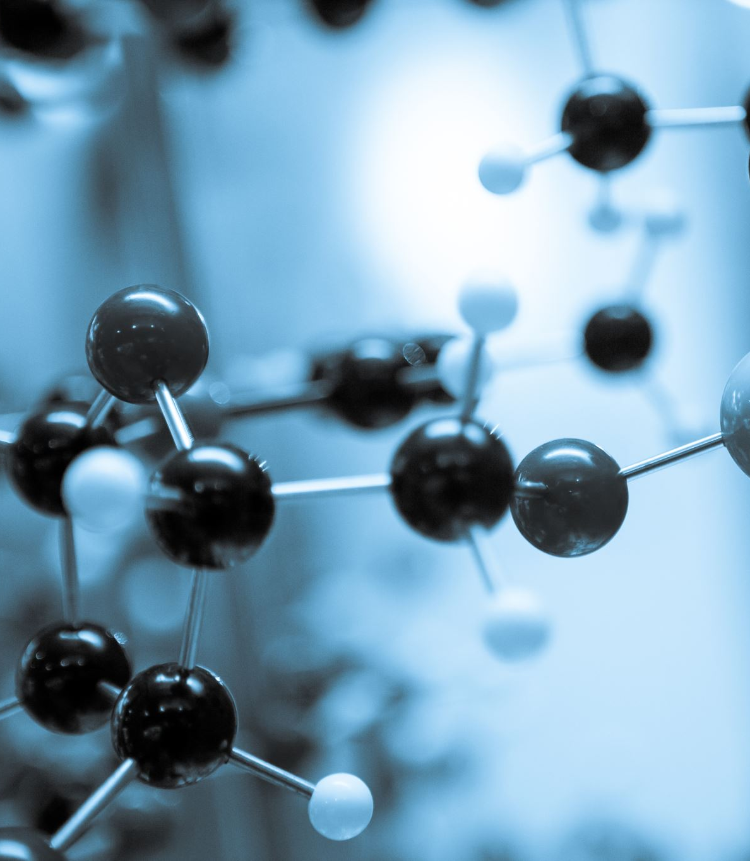

UNET IMAGE SEGMENTATION (ANALYSIS OF THE NEURAL NETWORK)
By : Priyanka Budavi
Mentor: Dr. Somya Mohanty

Slide 2
OUTLINE
Introduction
Goals & Challenges
Overall Flow Chart
Data
Tasks , Method and Algorithms
Results
Conclusion

Slide 3
Introduction
Deep learning is a type of machine learning and artificial intelligence (AI) that imitates the way humans gain certain type of knowledge
Machine learning performed better in most of the areas but when it comes to image recognition, speech recognition, it does not perform well.
Neural Networks have been applied to fields including computer vision, speech recognition, natural language processing etc. where they have produced results comparable to and in some cases surpassing human expert performance.
The project is divided into three stages i.e., building the architecture for image segmentation, training the model, and then analyzing the layers to understand the data extracted from the convolutional neural network.

Slide 4
Goals
The goal of this project is to build a neural network to classify building and non buildings and then extract the information from the intermediate layer and visualize these layers to understand what's going on in the neural network.
Determine the performance of the model using metrics such as precision and recall

Slide 5
Challenges
Amount of data - Neural Network require more data than the traditional machine learning algorithms and dealing with this isn’t an easy task. In our project the high-resolution images were resized so that we can work on our local machine
Computationally expensive – Since the data involved is huge and takes longer to train, high end processors are required so that training can be done smoothly. There were scenarios where the colab crashed while training data, so a piece of code was added to make sure my laptop stays active through out the training and the data was broken into batches and then appended together.
Time taken to train the model – Neural Networks take a long time to train the data sometimes even a week depending on the datasize.
Black Box – When the model predicts a label we do not know how or why the neural network came up with a certain output. For example, when you feed an image of a cat into the neural network and it predicts to be a car, it is very hard to understand what caused it to arrive at this prediction.

Slide 6
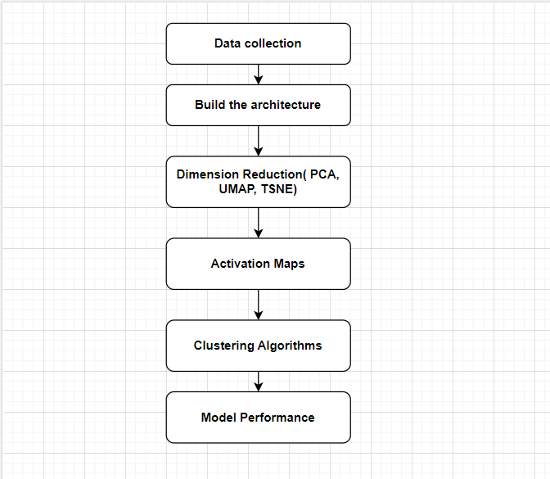
Overall Flow Chart

Slide 7
DATA
Dataset used in the project are aerial images of high resolution which were converted to shape of (1000, 1000) using ImageMagick library.
ImageMagick is a library which allows you to resize a single image or a batch of images. For this project, a batch of images were resized to the above-mentioned size to train the model.
The total of 500 images were converted to the desired size.

Slide 8
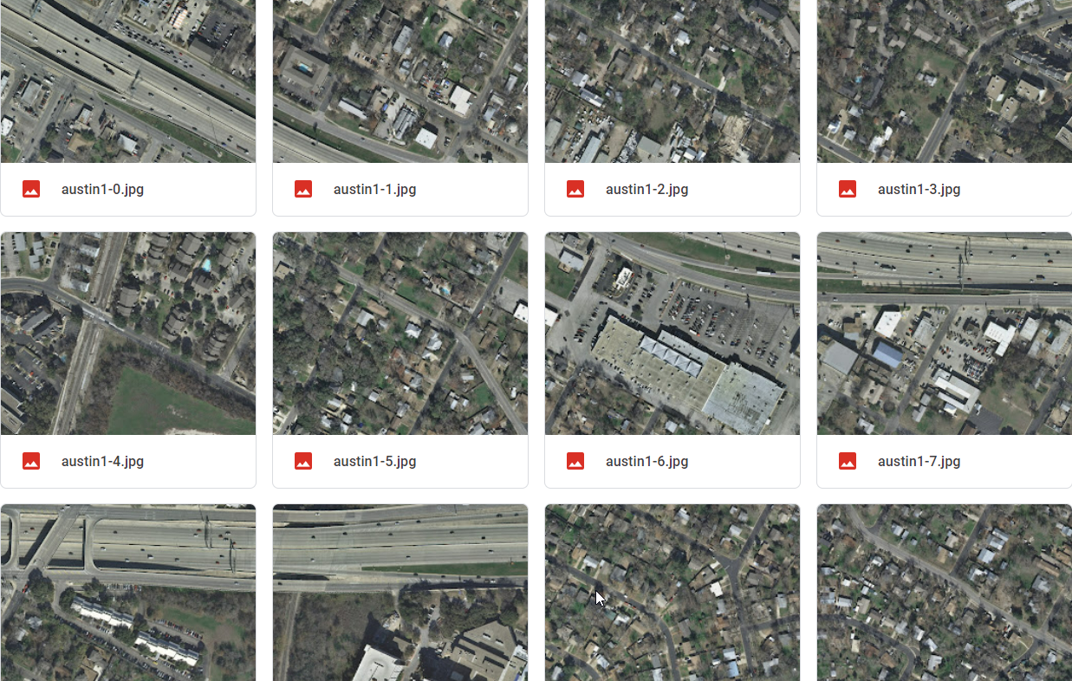

Slide 9
Task1 – The UNET Architecture
UNET was first implemented using biomedical images and that’s when the architecture became popular.
It is a fully connected convolution layer which is divided into 3 parts i.e Encoder , Intermediate Layer and Decoder.
The UNET created in the project is of 4 blocks of contracting path and 4 blocks of expansive path and the bottleneck layer or the intermediate layer.
This model can be modified according to our needs like add more convolutions, feed images to the desired size etc.

Slide 10
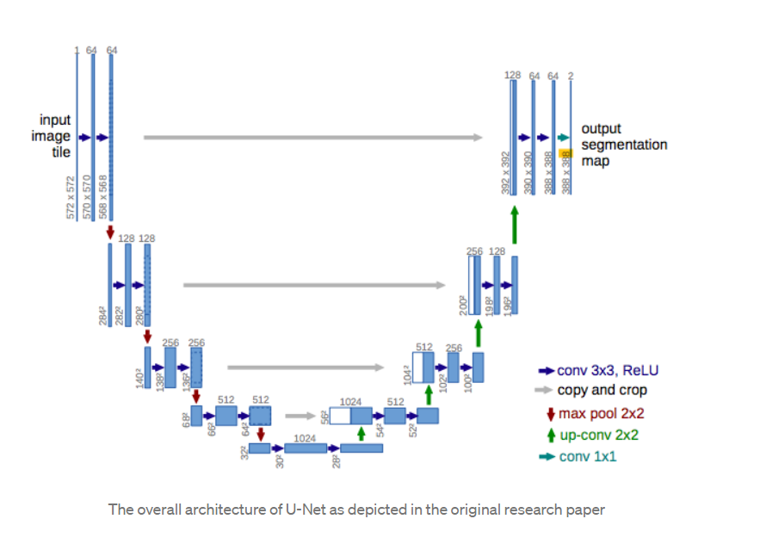
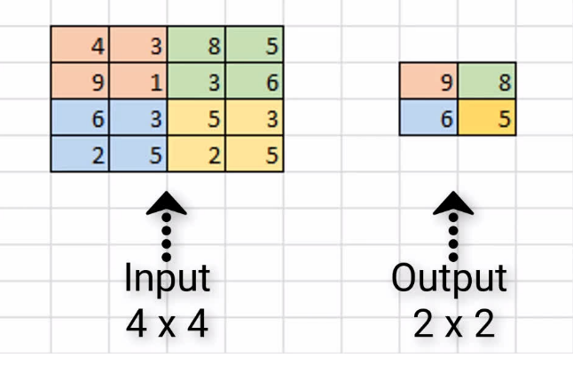
UNET Architecture used on Biomedical images
Max Pooling

Slide 11
Task2 – Extract the bottle neck layer
In this task we extract the information from the intermediate layer, and the output obtained is a tensor object. of shape (85,128 ,128, 512).
Each of the image is flattened to obtain a single vector and the final shape is (85, 8388608)
The data obtained is hard to understand and visualize so we use dimension reduction techniques to view the data.

Slide 12
Task3- Dimension Reduction
Many Machine Learning problems involve thousands of features, having such numerous features bring along many problems, the most important ones are:
- Makes the training extremely slow
- Makes it difficult to find a good solution
Sometimes reducing the dimensionality can filter out some of the noise present and some of the unnecessary details
Simplify complexity and remove redundancies
One of the most important aspects of Dimensionality reduction, is Data Visualization. Having to drop the dimensionality down to two or three, make it possible to visualize the data on a 2d or 3d plot, meaning important insights can be gained by analyzing these patterns in terms of clusters and much more.

Slide 13
Dimension Reduction Techniques
Dimension reduction, is the transformation of data from a high-dimensional space into a low-dimensional space so that the low-dimensional representation retains some meaningful properties of the original data.
The techniques used in this project are
PCA (Principal Component Analysis)
TSNE (T-distributed Stochastic Neighbor Embedding)
UMAP (Uniform Manifold Approximation and Projection)

Slide 14
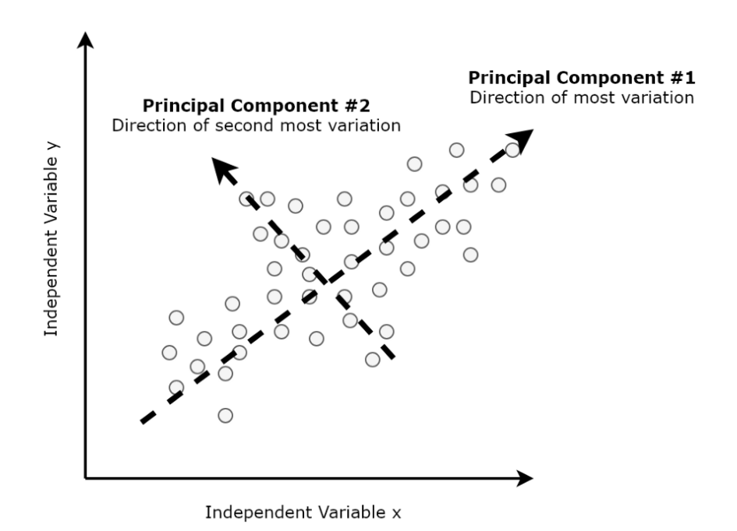
Principal Component Analysis
This works by identifying the hyperplane which lies closest to the data and then projects the data on that hyperplane while retaining most of the variation in the data set.
The line explain the variation in the datapoints and correspond to Principal Component.
The PCA discards the low variance data and keeps only the once with high variance this is because the more variance in the datapoints, the more information is stored.
The components are orthogonal to each other because they are not correlated which means they all contain unique pieces of information.
Looks at the global distances and cannot represent the complex relationship between features.

Slide 15
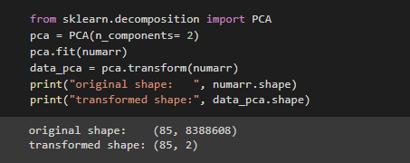
Principal Components Code

Slide 16
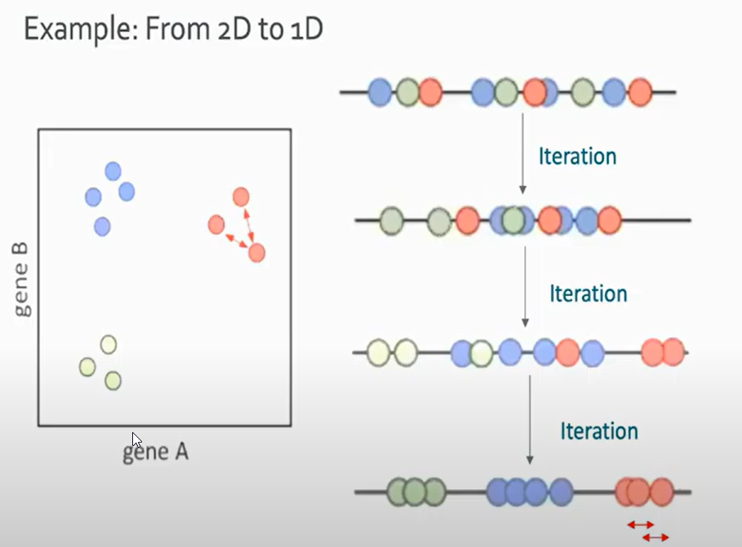
T-distributed stochastic neighbor embedding (t-SNE)
Unlike PCA, t-SNE can reduce dimensions with non-linear relationships. In other words, the change in X or Y does not correspond with a constant change in the other variable.
The data points are randomly scattered when move to a low dimension space.
Firstly, it constructs probability distribution and assigns similar points a higher probability and unsimilar points lower probability in high dimensional space
Secondly, each point gets randomly projected into a low dimensional space and calculates the similarity probability score in a low dimensional space in order to cluster the points together.
The algorithm iterates over and over till similar data points are grouped together.
Thus, it calculates a similarity measure based on the distance between points instead of trying to maximize variance.

Slide 17
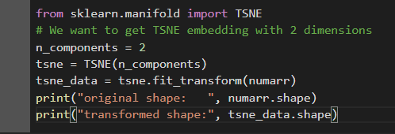
TSNE Code

Slide 18
Uniform Manifold Approximation and Projection
UMAP is similar to t-SNE but with higher processing speed, therefore, faster.
UMAP outperforms t-SNE and PCA. It is very effective for visualizing clusters or groups of data points and their relative proximities.
It calculates distances not only with the closest neighbor but also tries to map datapoints bit farther away using functions.

Slide 19
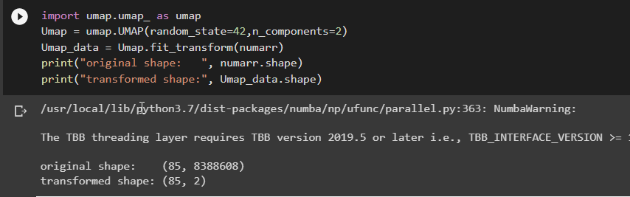
UMAP Code

Slide 20
Task4 - Class Activation Maps
Neural Networks classify an image and on what basis the prediction takes place is what the activation maps talk about.
Every pixel in the input layer is applied with the filter and here filter meaning matrix multiplication of values.
This matrix multiplication leads to a feature map , which store every information of the image.
The feature map is then used to visualize the image in the convolution layer as in which area of the image is being focused by the layer.
To get the class activation maps its required to build a model of the last layer and then get the activations of the layer using the images. This gives us a tensor output.

Slide 21
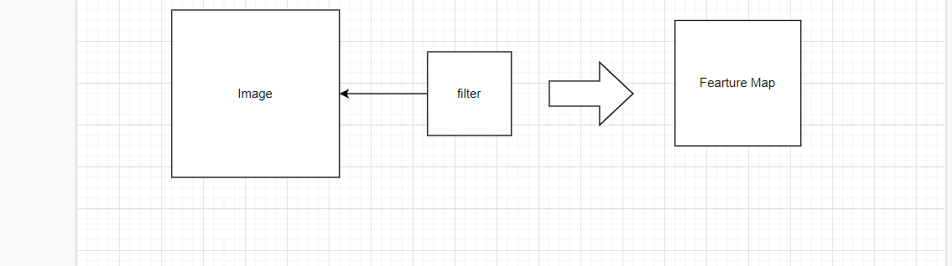

Slide 22
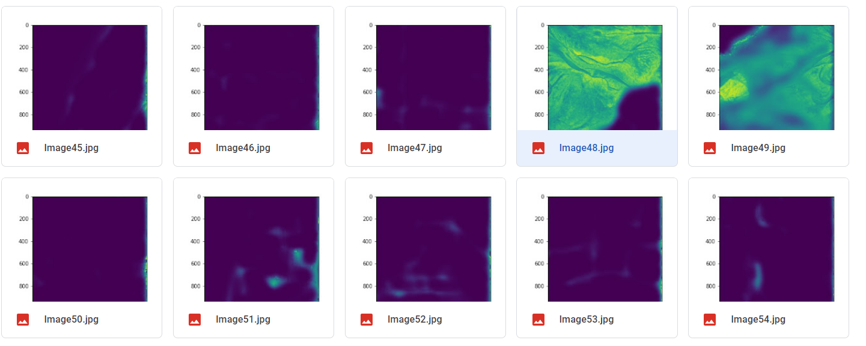
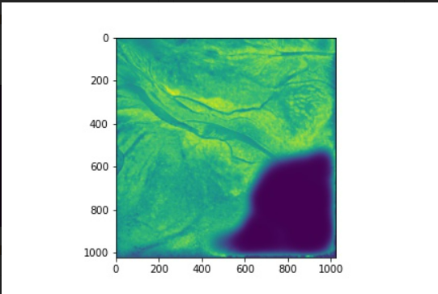
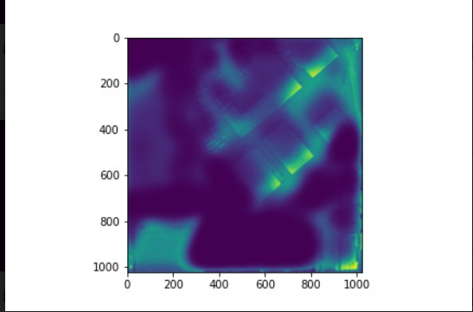
Outputs Using Activation Maps

Slide 23
Task5- Clustering Algorithm
K-means clustering is one of the simplest and popular unsupervised machine learning algorithms.
The objective of K-means is simple: group similar data points together and discover underlying patterns. To achieve this objective, K-means looks for a fixed number (k) of clusters in a dataset.
The activations obtained from the last layer were clustered to find the similarities within the data points.
To decide the optimal K value, elbow graph is used.
Silhouette Score a metric used to calculate the goodness of a clustering technique. Its value ranges from -1 to 1.
1: Means clusters are well apart from each other and clearly distinguished.
0: The distance between clusters is not significant.
-1: Means clusters are assigned in the wrong way.

Slide 24
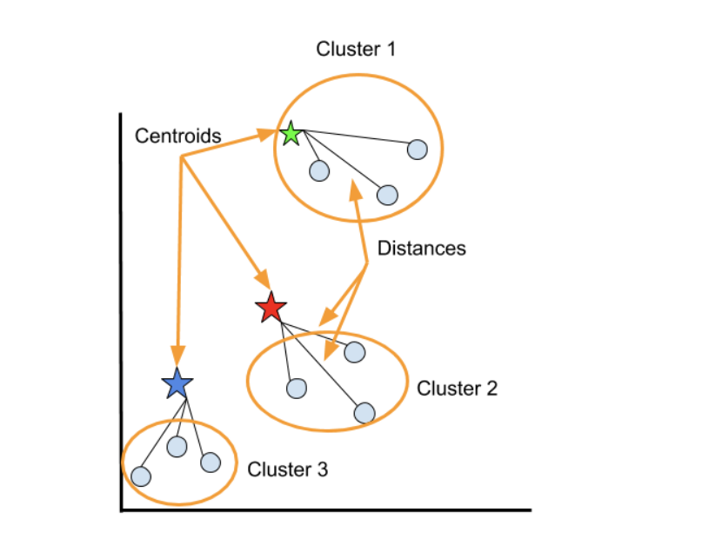
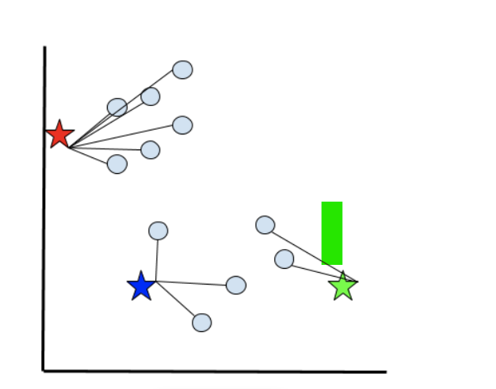
K-means algorithm Working
KMeans will select a random point for each centroid and the number of centroids is equal to the number of clusters selected.
The Euclidean distance is calculated between each point and each centroid. Each data point will be initially assigned to the closest centroid based on the Euclidean distance.
The algorithm then averages Euclidean distance (between each point and centroid) for each cluster and this point becomes the new centroid.
This process of averaging the Euclidean distances within clusters and assigning new centroids repeats until cluster centroids no longer move.

Slide 25
Task6 – Evaluating the performance of the model
Precision is a measure of how many of the positive predictions made are correct (true positives). The formula for it is:
Precision Score = TP / (FP + TP)
Recall is a measure of how many of the positive cases the classifier correctly predicted, over all the positive cases in the data.
Recall Score = TP / (FN + TP)
If there are no FNs and FPs at all, then the model makes perfect predictions, both precision and recall will be 1 but in reality, this is difficult to achieve.

Slide 26
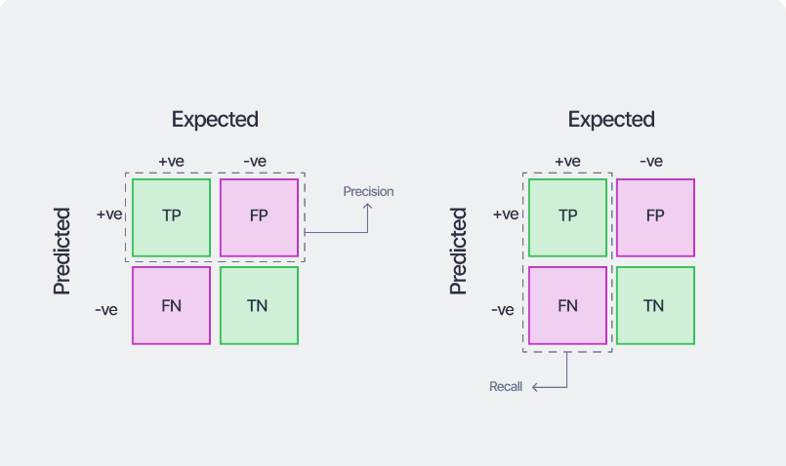
Confusion Matrix
True Positives (TP): The number of positive instances correctly classified as positive. E.g., predicting an email as spam when it is spam.
True Negatives (TN): The number of negative instances correctly classified as negative. E.g., predicting an email is not spam when it is not spam.
False Positives (FP): The number of negative instances incorrectly classified as positive. E.g., predicting an email is spam when it is not spam.
False Negatives (FN): The number of positive instances incorrectly classified as negative. E.g., predicting an email is not spam when it is spam.

Slide 27
Why Precision and Recall ?
Accuracy tells us how many times the model made correct predictions in the entire dataset. It does not give us any class-specific information like which class boundaries were learned well, where the model was more confused, etc.
In case of imbalanced dataset, the accuracy would be high and is not a reliable indicator of the model’s quality.
Precision and recall offer more insight into the model’s skill by elaborating its class-wise performance.

Slide 28

Results

Slide 29
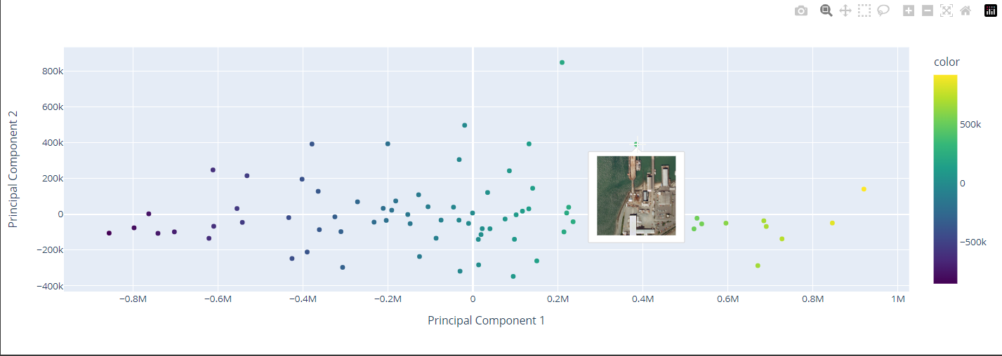
PCA

Slide 30
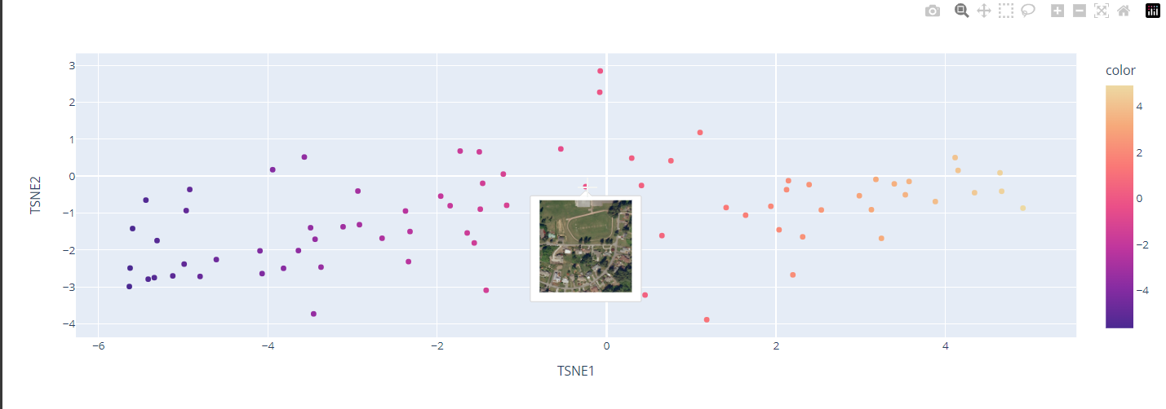
TSNE

Slide 31
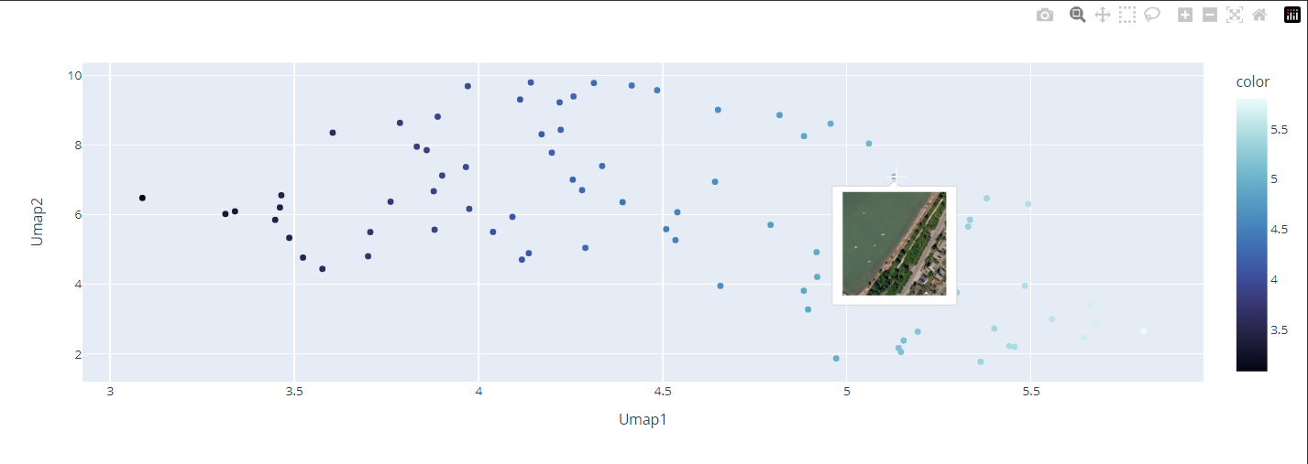
UMAP

Slide 32
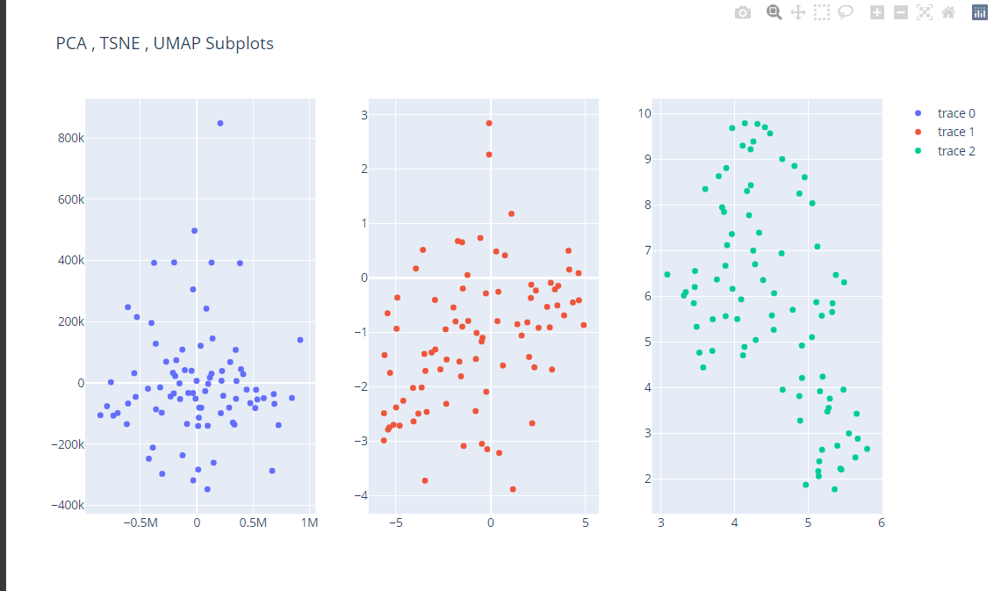
Compare PCA TSNE and UMAP

Slide 33
Activation Maps

Slide 34
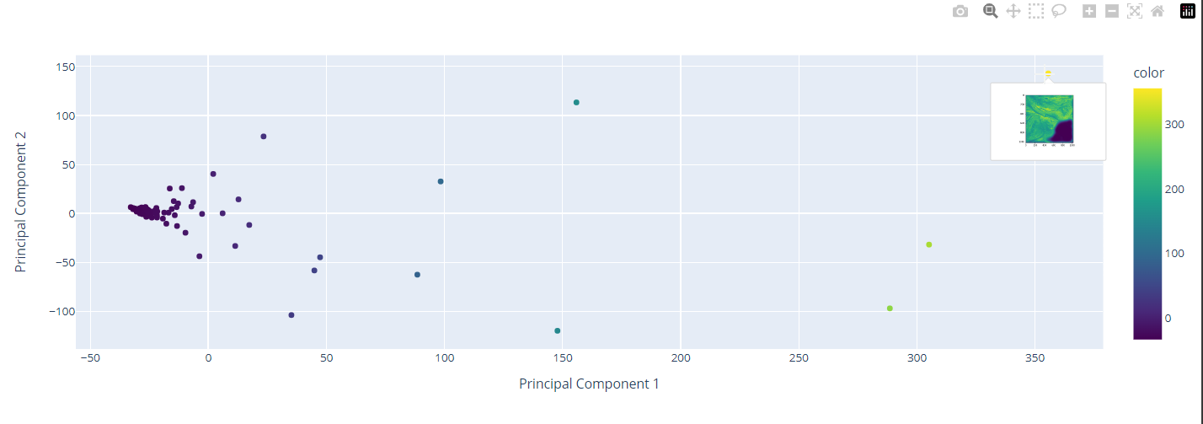

Slide 35
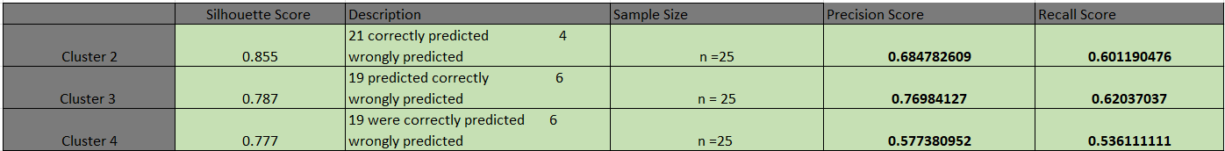
Model performance Using Kmeans Clustering

Slide 36
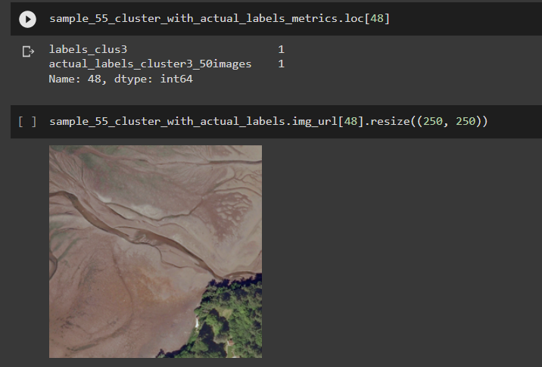
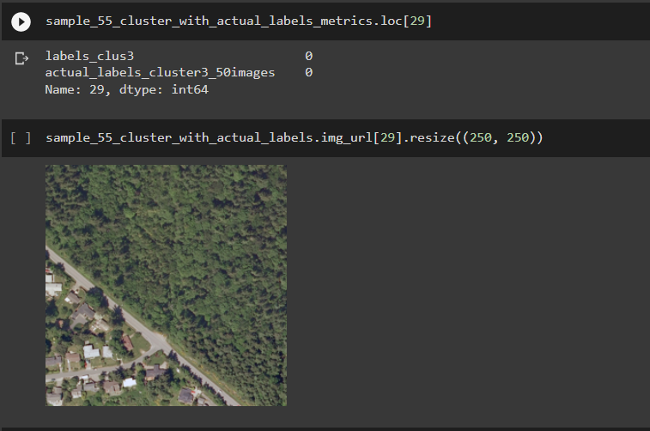
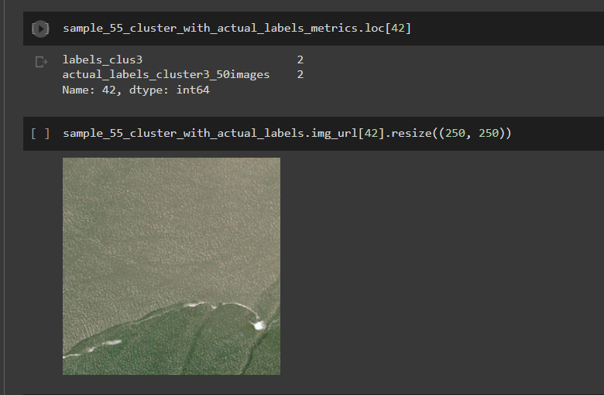
Correctly Predicted Class
Class 0 = Building
Class 1 = Sand
Class 2 = Water

Slide 37
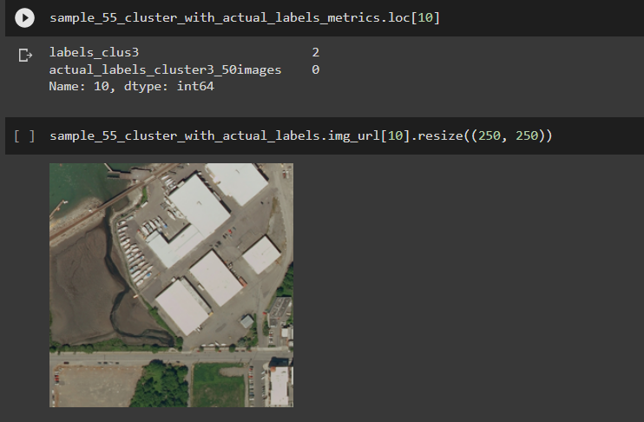
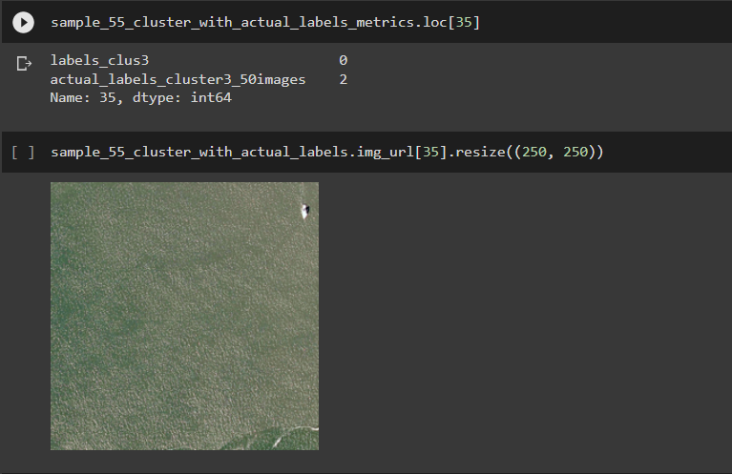
Wrongly Predicted Class
Class 0 = Building
Class 2 = Water

Slide 38
Conclusion
Neural network is a black box so using the data visualization we were able to see what's going on within the hidden layers.
The dimension reduction techniques helped us reduce the features and understand what going on with the data points.
Using Activations maps we were able to see which part of the image the layer is focusing on.
With the clustering we were able to form different clusters i.e. building, non-building, sand etc.
The model performance was pretty good as it was able to classify the images correctly.
Use the model in studying people analytics to help HR’s to get the attrition rate of the company and make improvements accordingly.

Slide 39
Any Question?

Slide 40
Thank you

